Slide 1
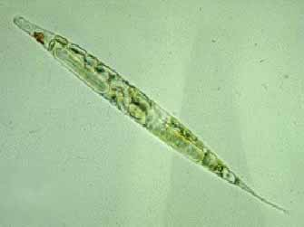
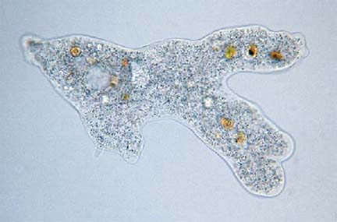
Protists
Pages 226-235

Slide 2
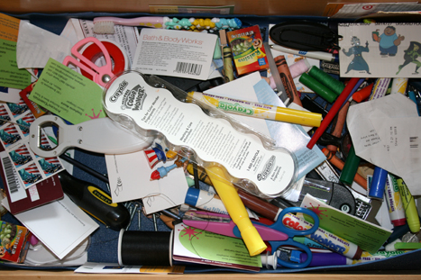
What are protists?
1. Protists are eukaryotes that cannot be classified as animals, plants for fungi.
2. They belong to the kingdom PROTISTA
It is described as the “odds and ends” or “junk drawer” kingdom
All organisms that don’t fit anywhere else are placed here

Slide 3
Protists continued
Diversity best describe protists!
Some are autotrophs and others are heterotophs
Some can move and some cannot
Some are unicellular and others are multicellular

Slide 4
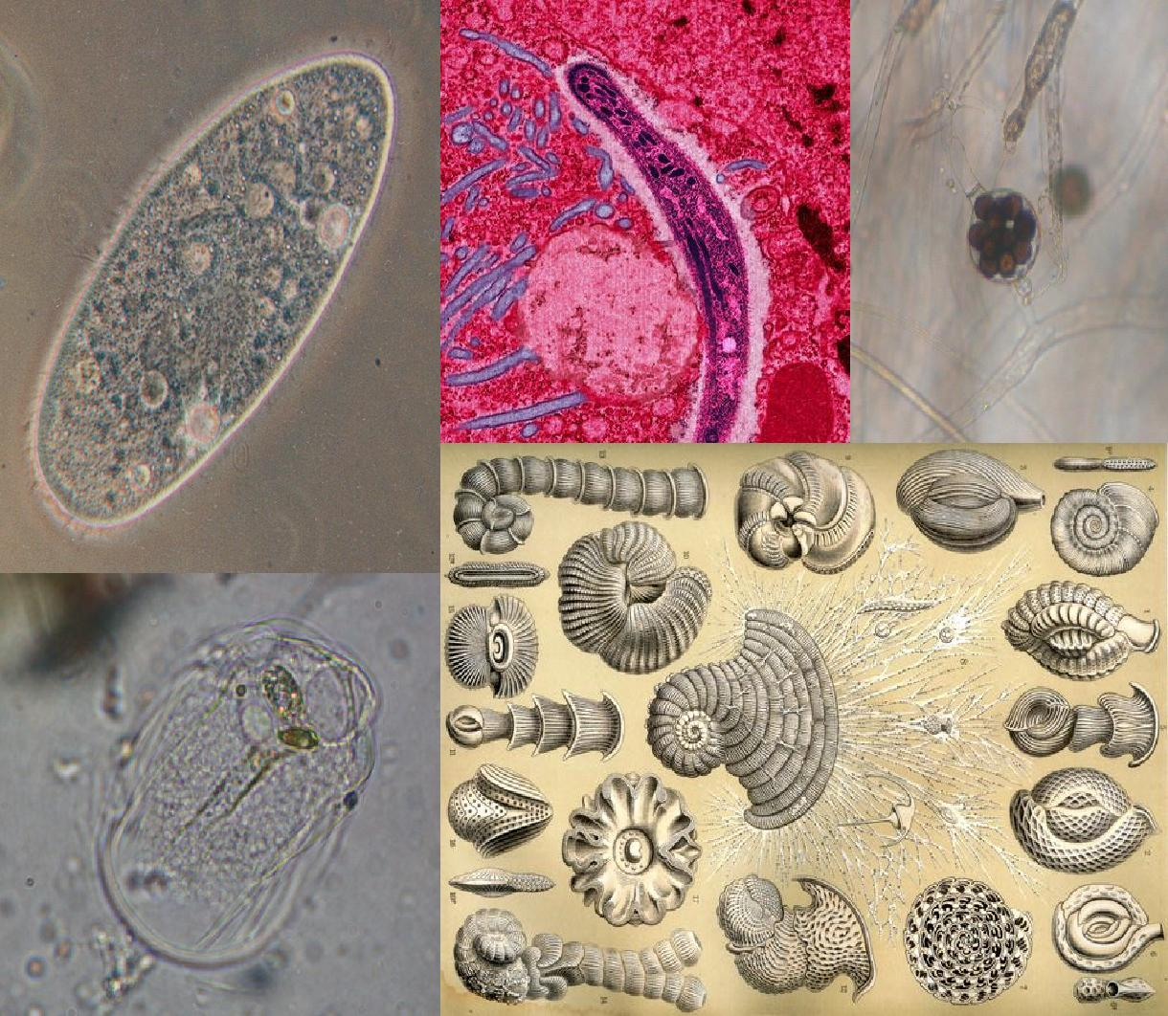
Diversity

Slide 5
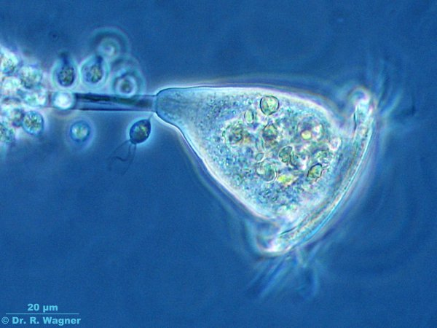
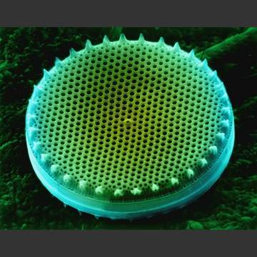
Protist Classification
Protists are grouped in categories based on their characteristics:
Animal-like
Plant-like
Fungus-like

Slide 6
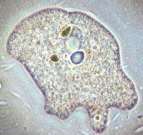
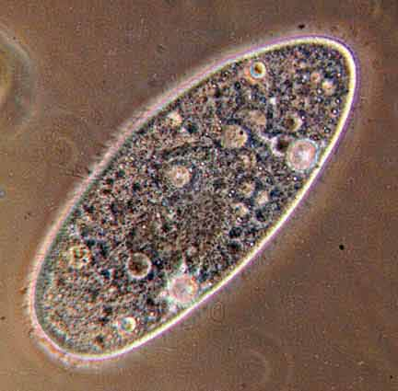
Animal-Like Protists - PROTOZOA
Characteristics of animal-like protists
Heterortrophs – ability to make their own food
Can move from place to place
Also known as Protozoans

Slide 7
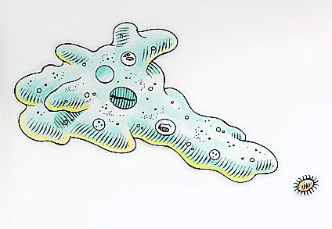
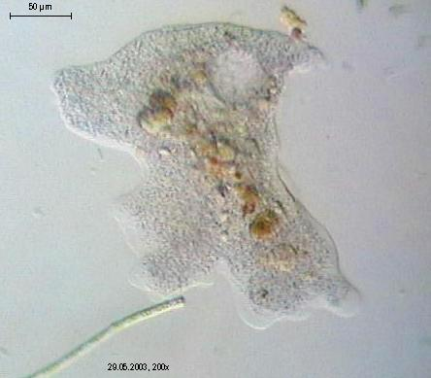
Protozoans with Pseudopods
6. A pseudopods are temporary bulges of the cell
7. Literally means “false foot”

Slide 8
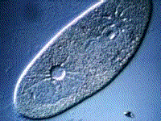
Protozoans with Pseudopods
8. amoebas prevent excess water from building up inside of them with a contractile vacuole.
All protozoans live in moist areas
Amoebas live in fresh water
Water is easily able to pass through cell membrane
If too much excess water was in the cell, it would burst!

Slide 9
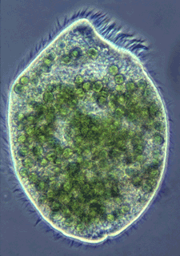
Protozoana with Cilia
9. Protozoans with cilia are called ciliates.
10. Cilia are hairlike projections from cells that move with a wavelike motion.
Cilia are used for movement and to get food

Slide 10
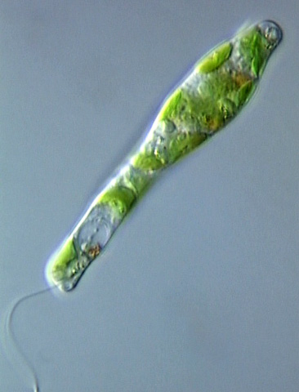
Protozoans with Flagella
11. Protozoans with flagella are called flagellates.
12. Some of these flagellates live in the body of other organisms.
Intestines of termites
Human intestines

Slide 11
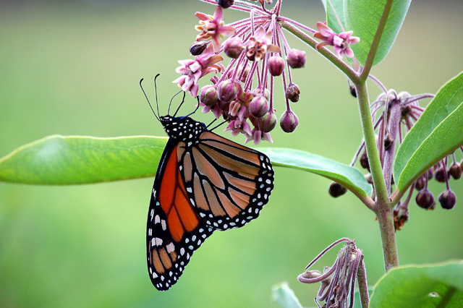
13. Symbiosis vs Mutualism
Symbiosis: Close relationship in which at least one of the species benefits
Mutualism: When both partners benefit from living together

Slide 12
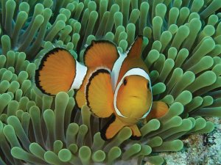
14. Symbiosis Example
Clown fish and sea anemone

Slide 13
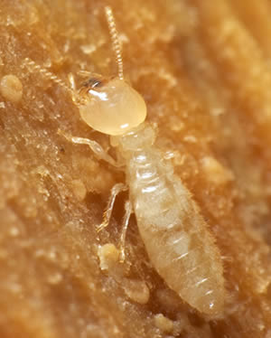
14. Mutualism Example
Termite’s have parasites that live in their intestines to break down wood

Slide 14
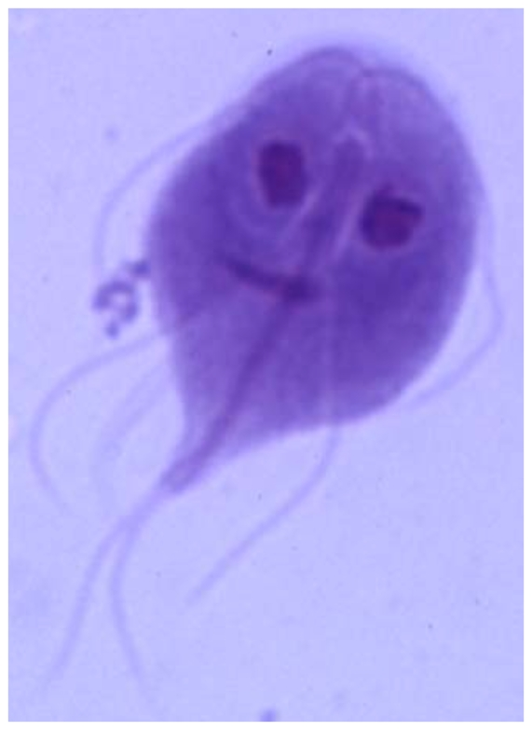
Protozoans that are Parasites
15. Parasite: The organism that benefits by living on or in a host in a parasitism relationship
16. Movement:
Some have flagella
Others depend on host for transportation
Slime!

Slide 15
Plantlike Protists
17. Plant-like protists are commonly called algae
18. Algae get their food by capturing sunlight and converting it into energy.
This process is called photosynthesis.
19. Since algae can make their own food, they are
Autotrophs

Slide 16
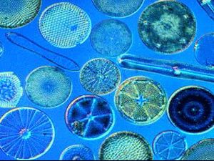
20. Plant-like Protists
1. Diatoms
B: Have beautiful glass-like cell walls
They contain some of the same elements that make up glass

Slide 17
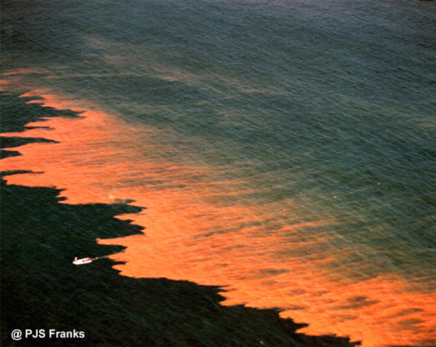
20. Plant-like Protists
2. Dinoflagellates
C. Are covered by stiff plates and move using two flagella
Many are also able to glow in the dark

Slide 18
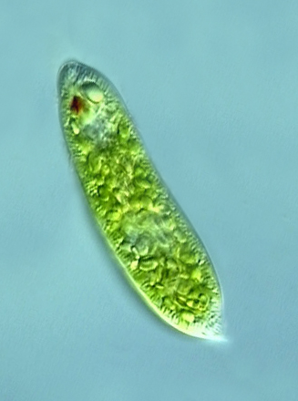
20. Plant-like Protists
3. Euglenoids
E. Can be heterotrophic when sunlight is not available
Live mostly in fresh water

Slide 19
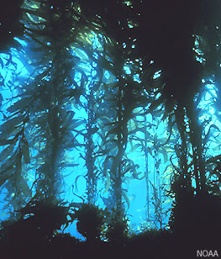
20. Plant-like Protists
4. Red and Brown Algae
A: Live in oceans
Multicellular seaweeds

Slide 20
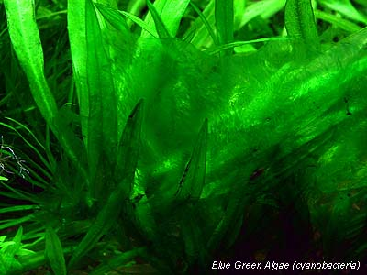
20. Plant-like Protists
5. Green Algae
D. Live in freshwater, salt water and moist places on Earth
Some scientists think this group should be in the plant kingdom

Slide 21
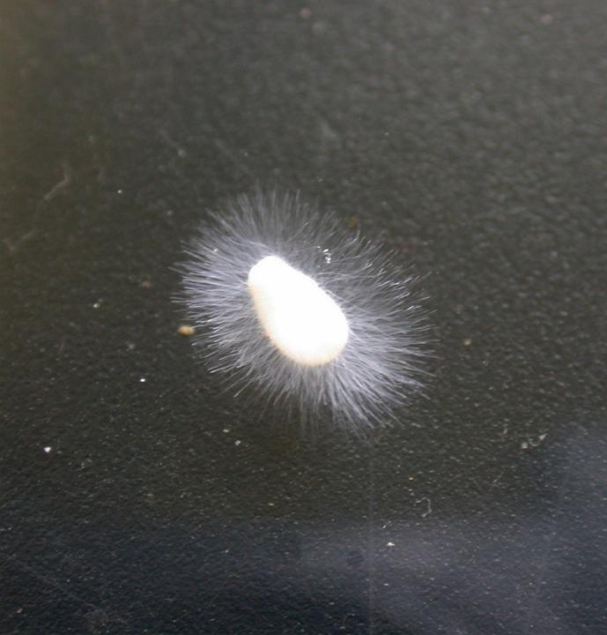
Fungi-Like Protists
21. Three characteristics of fungi-like protists
Heterotrophs – cannot make their own food
Have cell walls (like plants)
Use spores to reproduce

Slide 22
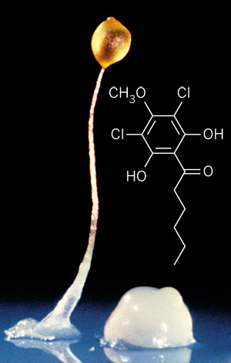
Fungi-Like Protists
22. A spore is a tiny cell that is able to grow into a new organism.

Slide 23
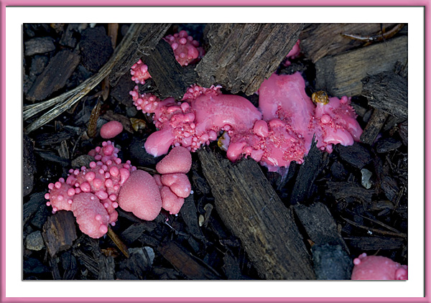
Fungi-like Protist Examples
23. Slime molds, water molds and downy mildews

